Slide 1
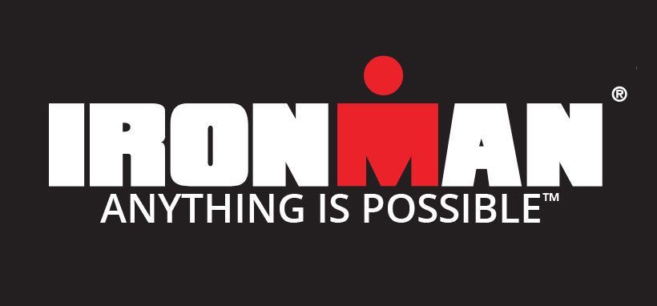

Slide 2
The Ironman triathlon
History
Some facts

Slide 3
The Ironman triathlon
3.86km swim
180.25 km bicycle ride
42,20 km run (marathon)

Slide 4
II. History
Created in 1977 in Hawaii
First Ironman triathlon in 1978
Worldwide recognition in 1980

Slide 5
II. Some facts
Course record : Patrick Lange
Physically challenged athletes
Team Hoyt

Slide 6
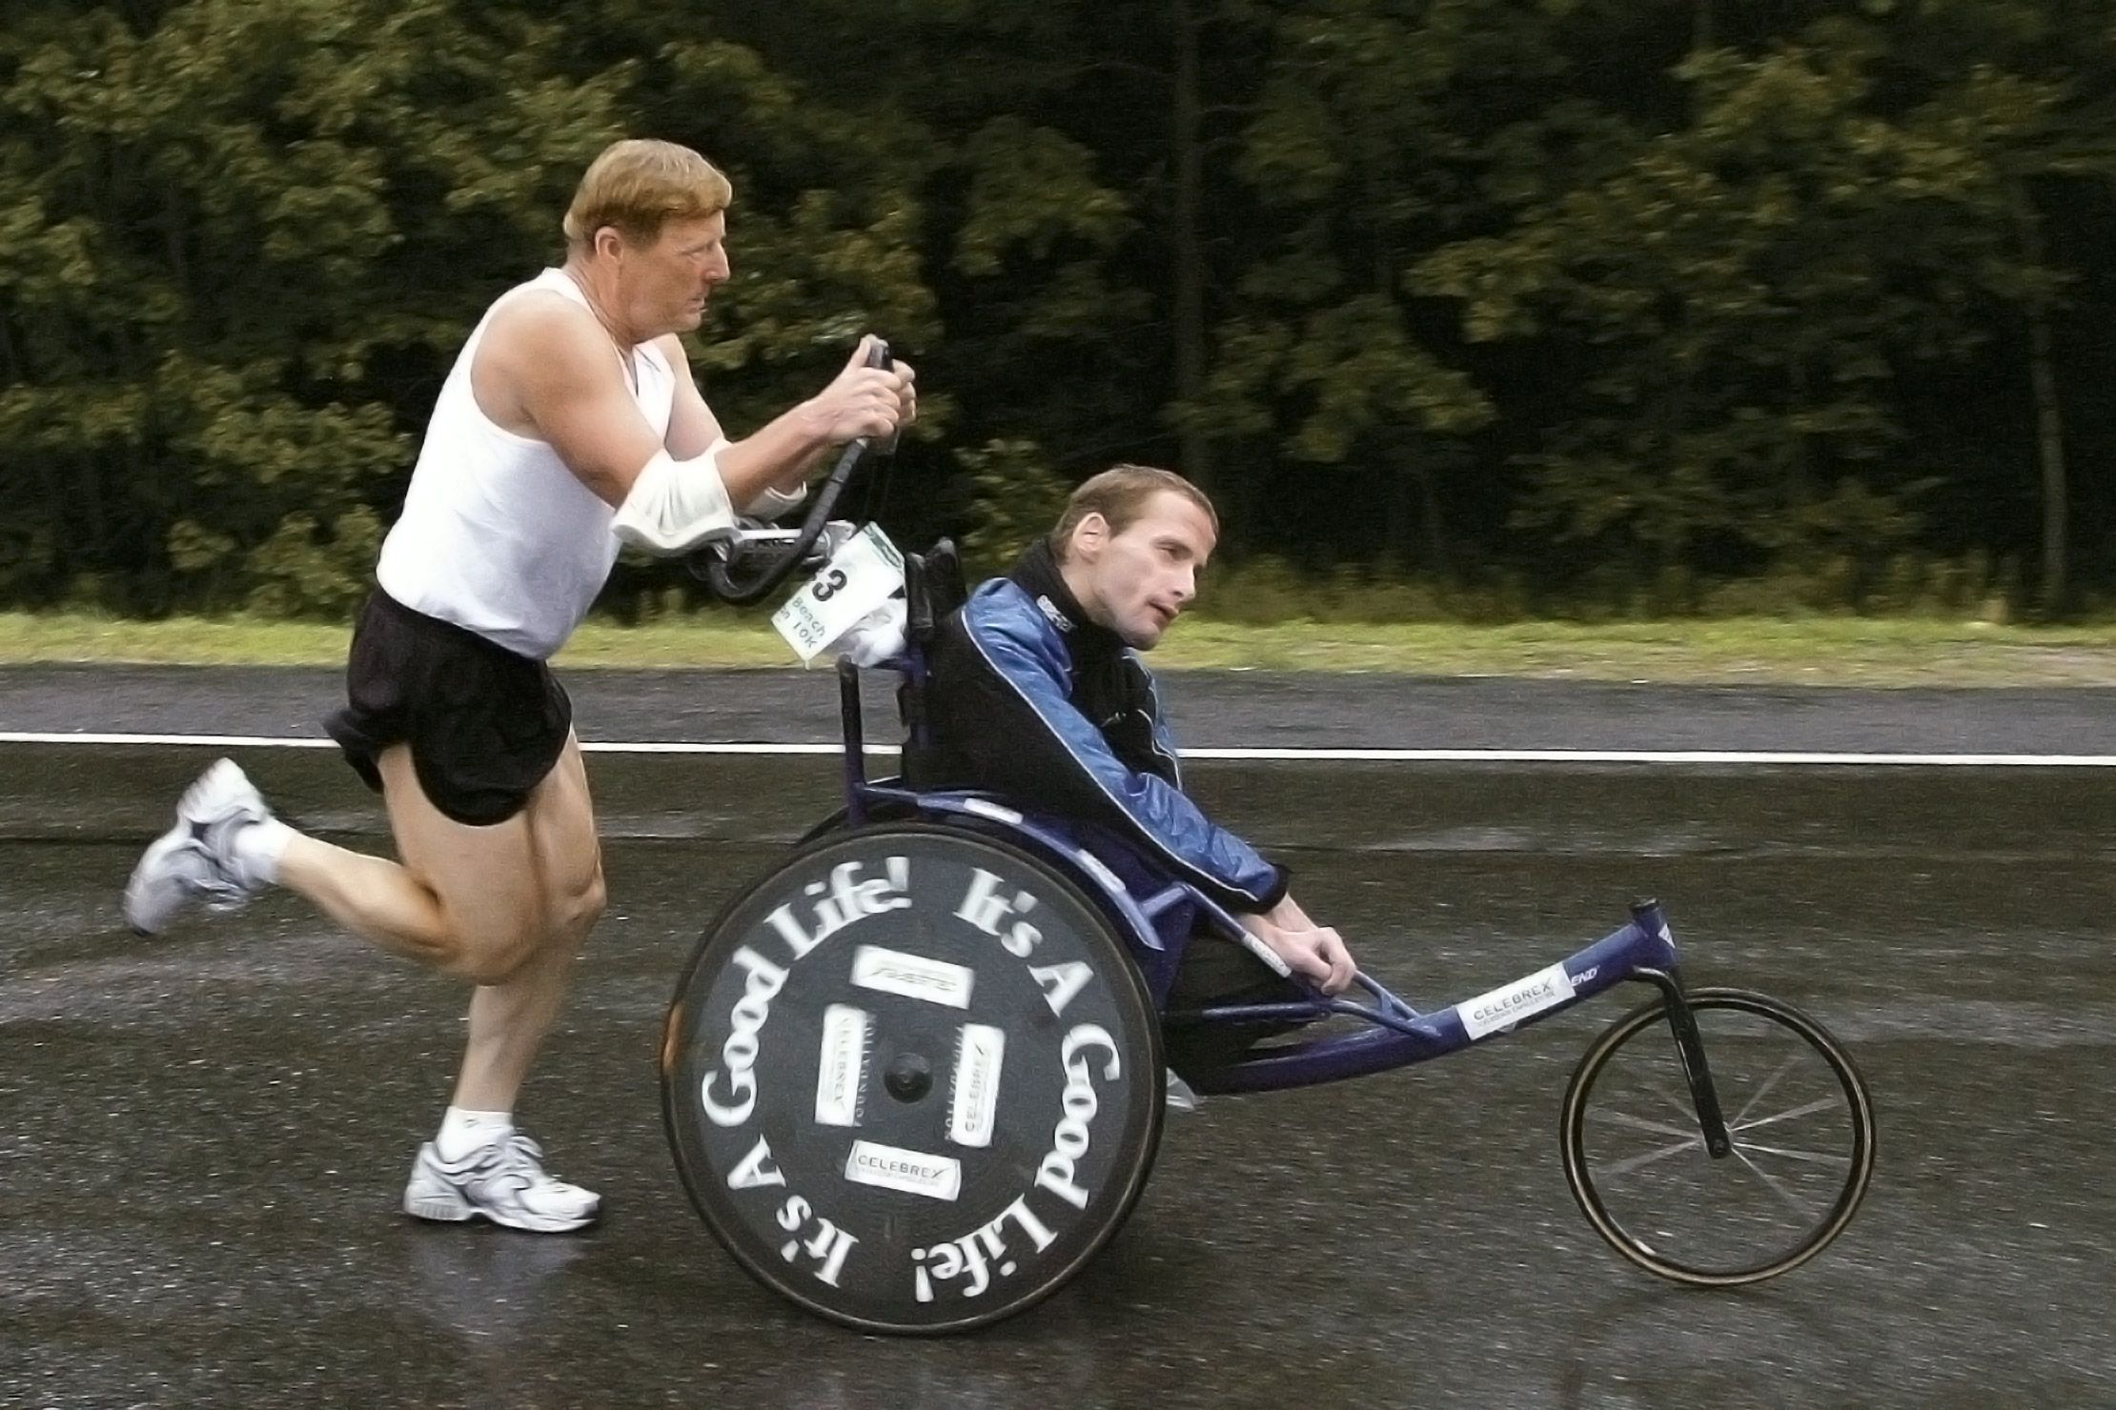
II. Some facts

Slide 7


